Slide 2
Objectives
Understand each of the following printing devices and why they are required
Inkjet printer
Laser printer
3D printer

Slide 3
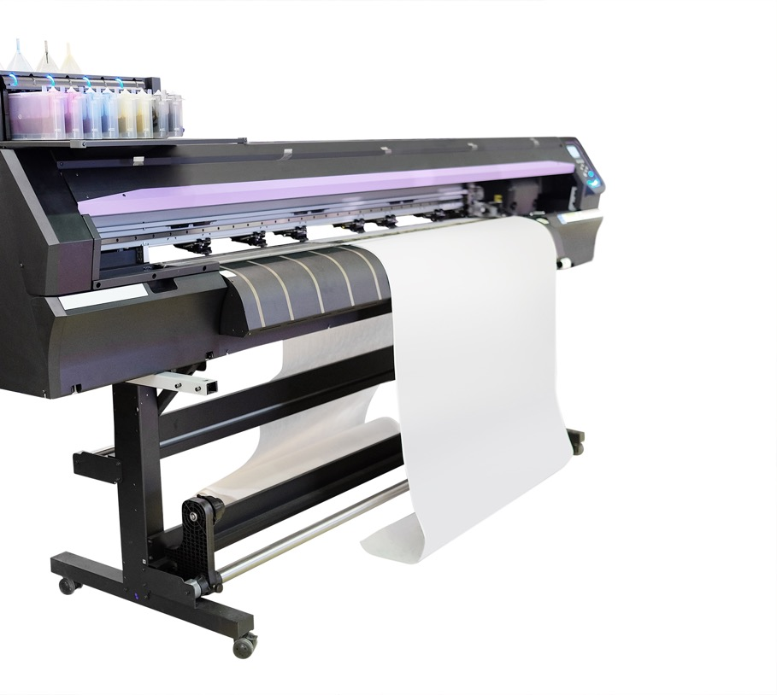

Starter
Printers are made using many different technologies
List at least three different technologies that are used to make printers

Slide 4
Starter
Printer technologies for this topic
Inkjet printers
Laser printers
3D printers
Other printer technologies
Lithographic – used for books and magazines
Screen printing – for clothes and fabrics
Dot matrix – used on older printers such as till receipt printers
Thermal printers – used to print receipts

Slide 5
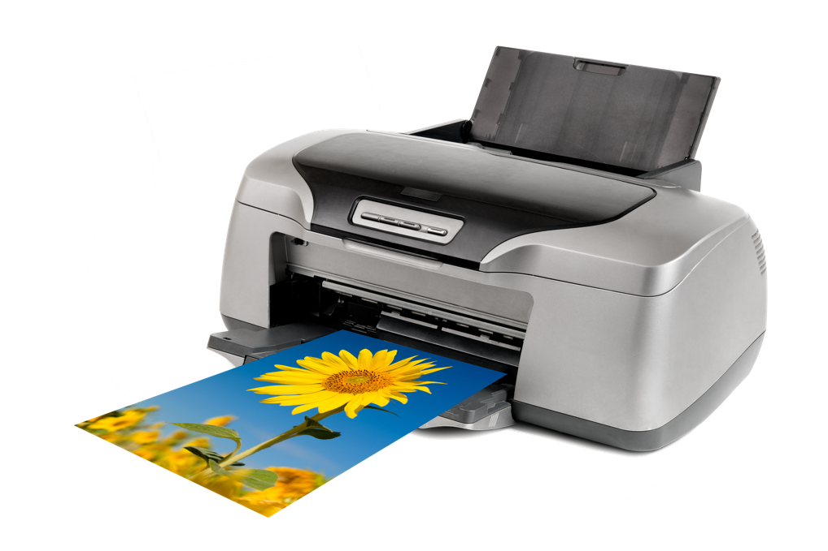
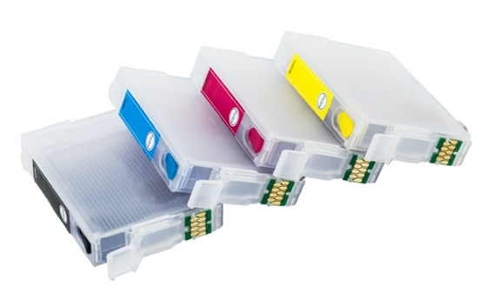
Inkjet printers
There are two main types of inkjet printer with similar internal workings
Thermal bubble
Piezoelectric crystal

Slide 6
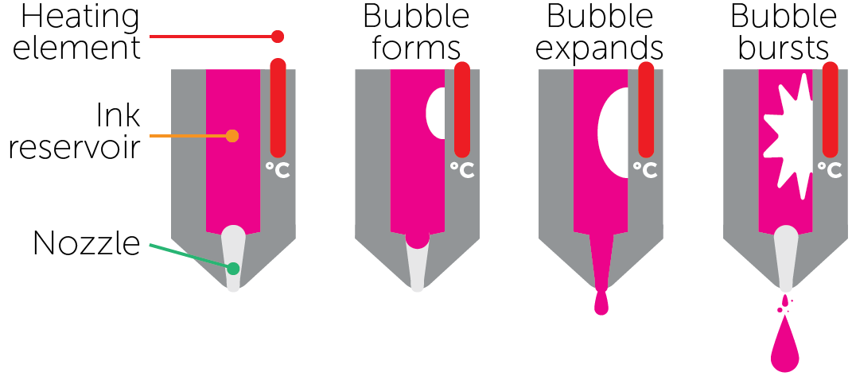
Thermal bubble
Droplets of ink are produced using a thermal bubble
Behind hundreds of print nozzles there are tiny resistors that create heat
The heat causes the ink to vaporise and form tiny bubbles
As each bubble expands, ink is ejected onto the paper
As it cools, the bubble collapses and draws in fresh ink and the process continues until the page is printed

Slide 7
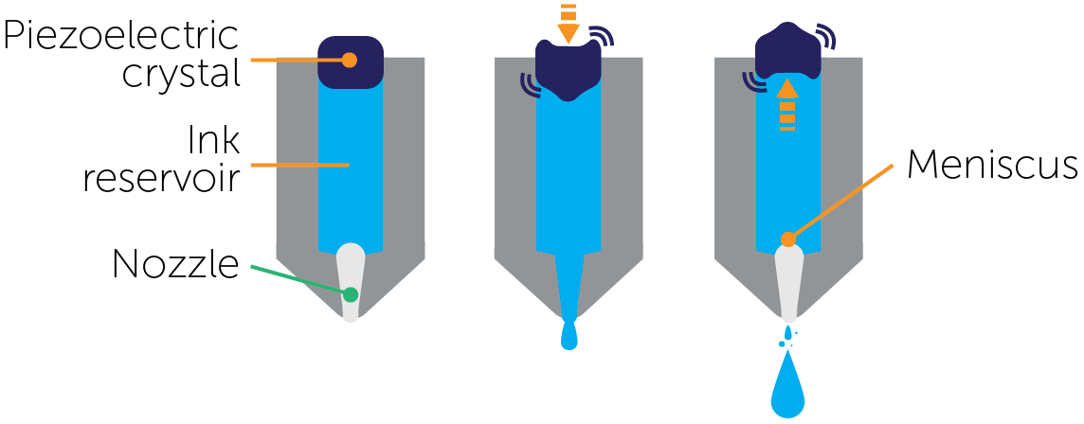
Piezoelectric crystal
A small piezoelectric crystal is located at the rear of each ink reservoir of each nozzle
When the crystal receives a small electric current, it begins to vibrate in and out
As it vibrates inwards, ink is ejected onto the paper
As it vibrates outwards again, new ink is drawn in to replace it

Slide 8
Comparison of thermal bubble and piezoelectric crystal
 | Thermal bubble | Piezoelectric crystal
Benefits | Less expensive technology than piezoelectric Possible to use more print nozzles | Very precise ink drop sizes can be produced Wide range of ink types can be used Can produce very small ink droplets Can run for longer since less heat is generated
Drawbacks | Produces larger droplet sizes Only certain inks can be used because of the high heat More maintenance needed because of the high temperatures involved | More expensive technology than thermal bubble Can use fewer print heads

Slide 9
Worksheet 5
Complete Task 1 on Worksheet 5

Slide 10
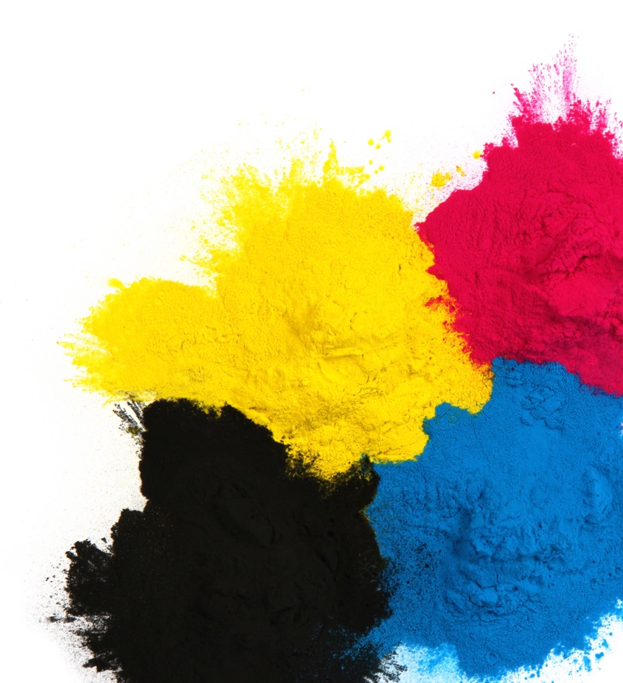

Laser printers
Laser printers use dry toner rather than liquid ink as in inkjet printers
The laser will scan across the print drum to apply an electrostatic charge to it
The drum will pick up a charged powder known as toner
The toner will stick to the paper
A heated fuser then makes sure the toner can’t be rubbed off the page
Pages are printed faster than inkjet printers

Slide 11
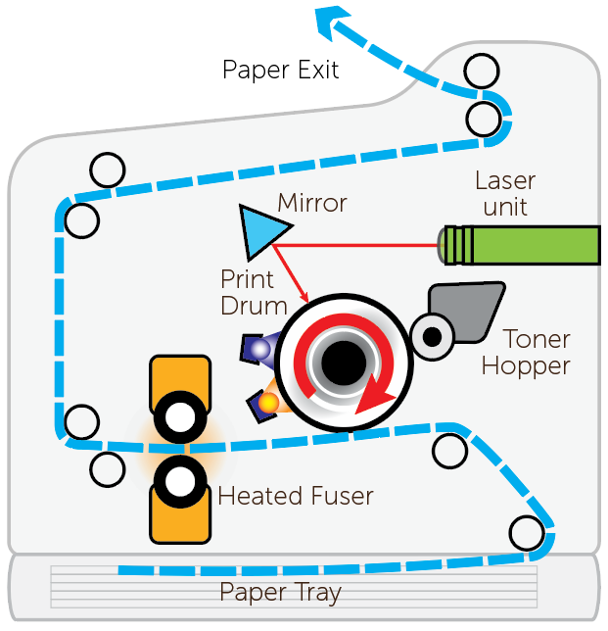
Inside a laser printer

Slide 12
Worksheet 5
Complete Task 2 on Worksheet 5

Slide 13
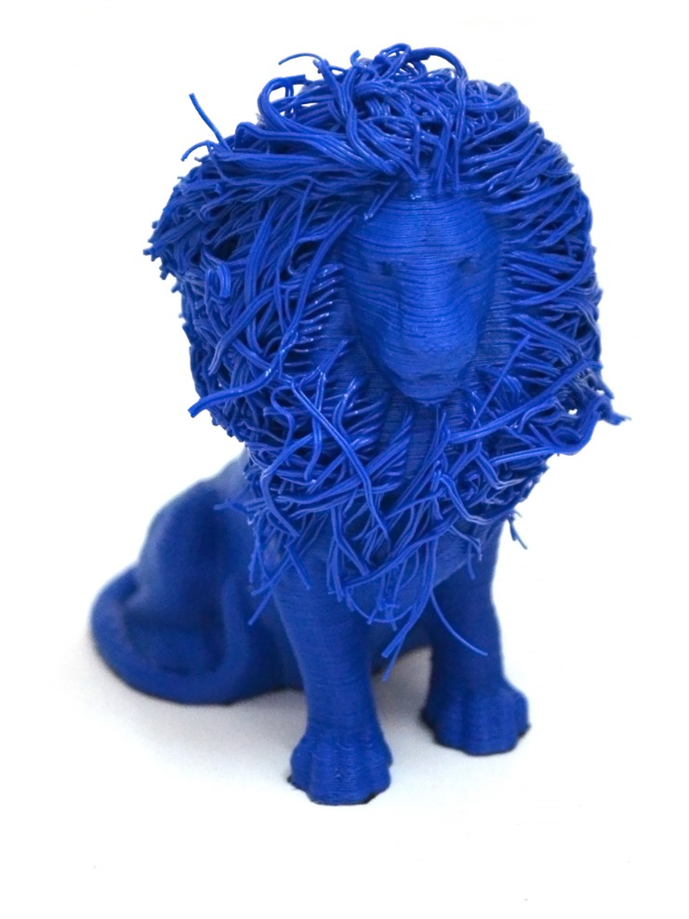
3D printers
3D printers can print using plastic filament, powdered resin, ceramic or metal powder, or paper
Intricate objects can be printed, including hollow areas

Slide 14
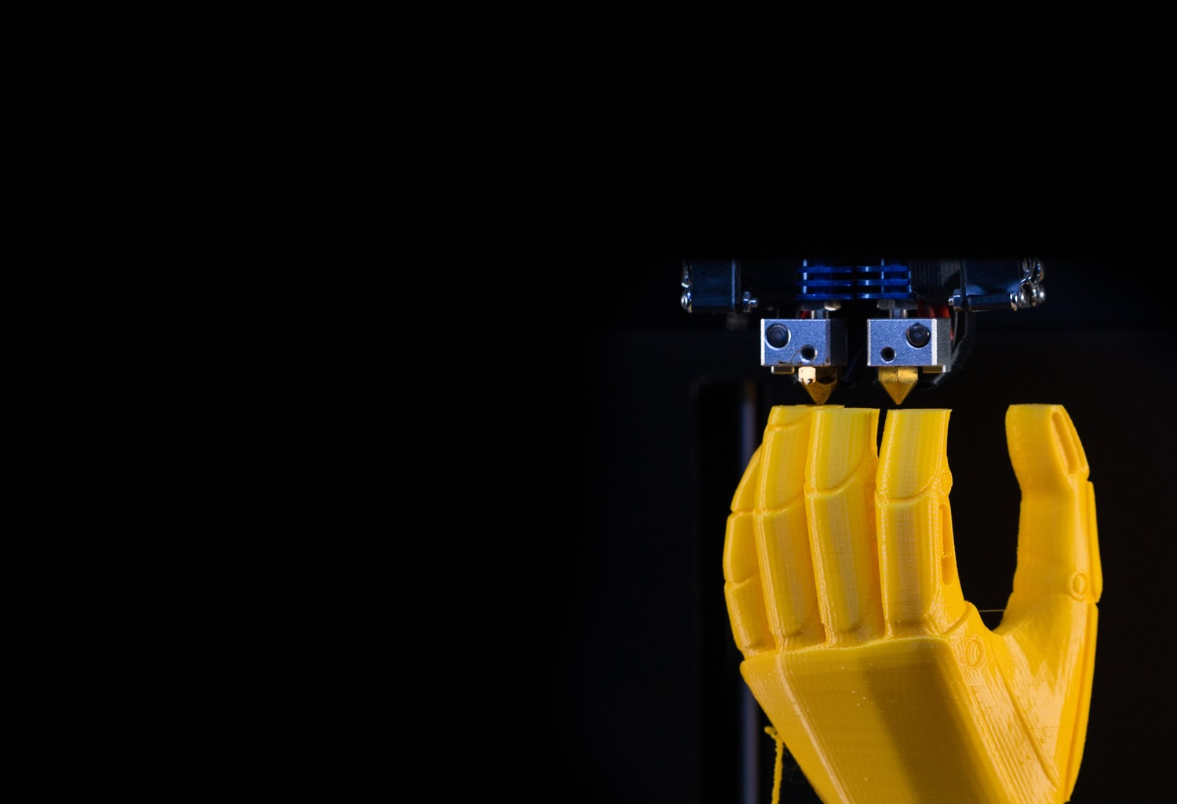
Uses of 3D printers
3D printers produce physical objects
These may be custom made parts or aesthetic objects
Recently, 3D printers have also begin to be used for:
Food printing
House building
Replacement parts
Medical devices

Slide 15
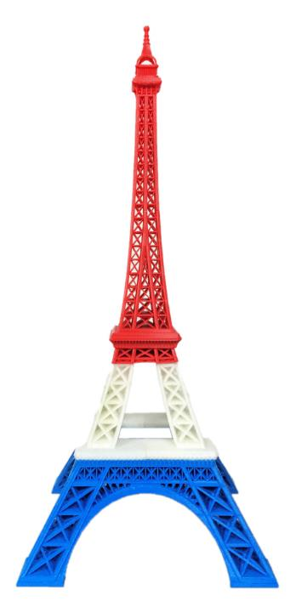
Additive and subtractive manufacturing
Additive manufacturing builds up an object layer by layer
This is very different to subtractive manufacturing where an object is made by removing material (such as a sculptor or a lathe)
For example, a statue could be made from powdered stone and built up layer by layer
A sculptor could otherwise remove stone from a large block to make the same statue

Slide 16
Direct and binder printing
Direct 3D printing is based on inkjet printer technology
With 3D printers, the print head doesn’t just move left to right, but it also moves up and down to create the 3D model
Liquid plastic is squeezed through a nozzle to make each layer
Binder 3D printing involves two passes to produce each layer of the object
One pass sprays dry powder and another pass sprays a binder (a type of glue) to make the layers stick together
What applications are there for 3D printed products?

Slide 17
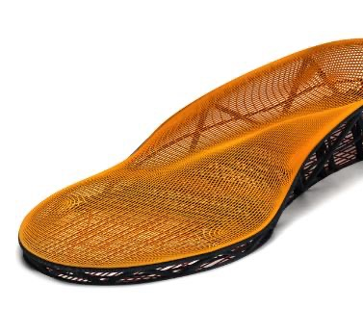
Applications in medicine
3D printers are used to manufacture devices such as prosthetic limbs or specialist footwear
Using 3D printers leads to a reduction in cost and a greater accuracy in matching product to individual patient
Reconstructive surgery or general surgery
Very accurate parts are able to be printed for surgical procedures

Slide 18
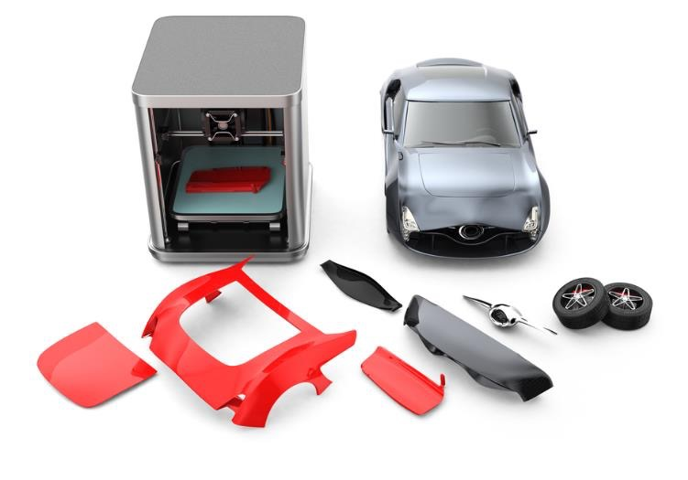
Applications in manufacturing and art
Manufacturing parts for cars
Very old cars are very likely to need parts no longer manufactured; by 3D scanning an existing part, this can be used as a blueprint to make replacement parts
Designers are able to quickly make multiple prototypes to test their ideas

Slide 19
Worksheet 5
Complete Task 3 on Worksheet 5

Slide 20
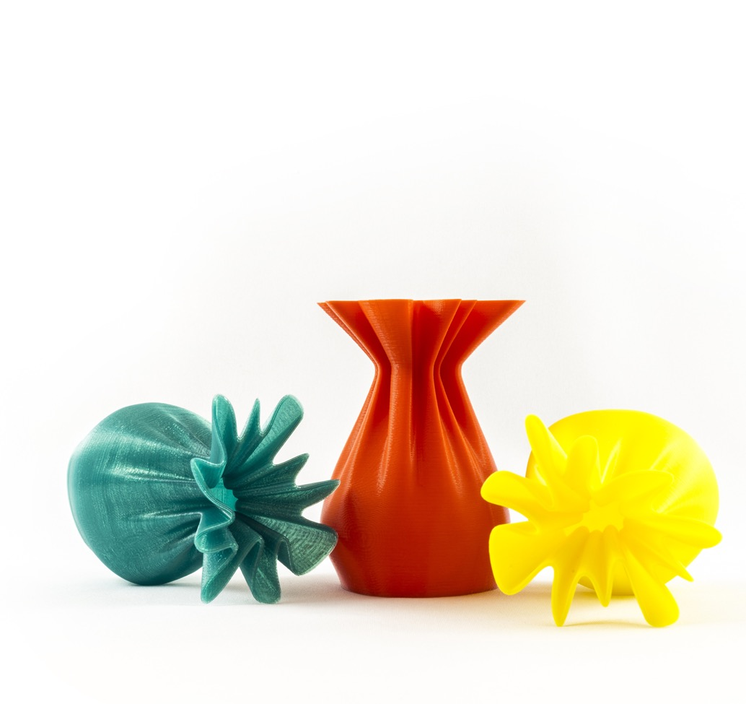
Plenary
Work with a partner to answer the following questions:
What are three different types of printer?
How does each type work?
Give an example where each type is used.

Slide 21
Plenary
Inkjet printer
Ink is ejected from many nozzles. The print head moves across the page to print each part of the page. This technology is common in home printers and for photo printing
Laser printer
A laser scans across a print drum which then picks up toner which then sticks to the paper. A page is printed quickly and the quality is high for text. These printers are used in businesses and the same technology is used in photocopiers
3D printer
A plastic is squeezed from the head. A 3D model is built up in layers. Uses in prototyping and custom objects.

